Slide 1
Neural Networks
Emulating the human brain
http://Reboot.ai

Slide 2
Agenda
Who: Who is this guy?
Why: What problem do neural networks (NN) solve?
What: What are NNs anyway?
How: How do NNs work?
High Level Description
Technical Deep Dive
Code Walkthrough

Slide 3
About Me
Who?
BBA Emory University – Finance
Finance
Excel API Specialist – Bloomberg
Lead Investment Trader – Algorithmic Desk – Macro Hedge Fund
Writing
Author 2 sci-fi novels
Short work published in print and online including The New York Times
Development
Immersive Bootcamp & Self Taught
Full stack Web Developer: websites, apps, games, chatbots, open source, etc.
Professional Scrum Master (PSM I) & Professional Scrum Product Owner (PSPO I)
Avid futurist- AI, blockchain, IOT, & social ramifications

Slide 4

But Why Neural Networks?
Why?
1) The universe is complex…
Non-linearity and >3 dimensional data structures
Cases for which no mathematical model exists
2) Parallelized computations
Independent calculations at scale
Ex. Image recognition
3) ‘Self teaching’
Don’t have to be programmed
Can ‘learn’ and improve

Slide 5
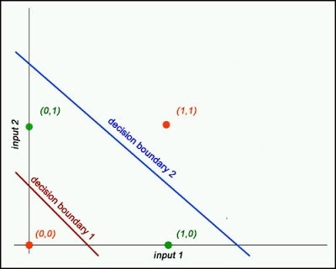
1) Complex Data - Problem
Why?

Slide 6
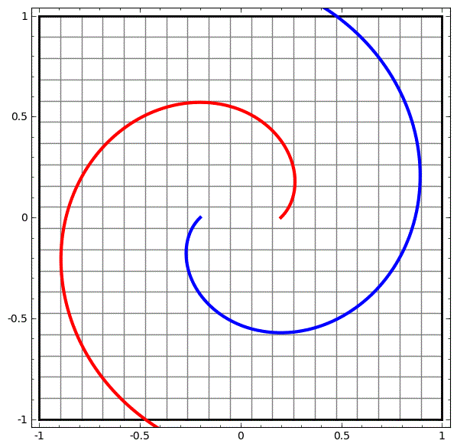
1) Complex Data - Problem
Why?

Slide 7

1) Complex Data - Solution
Why?

Slide 8
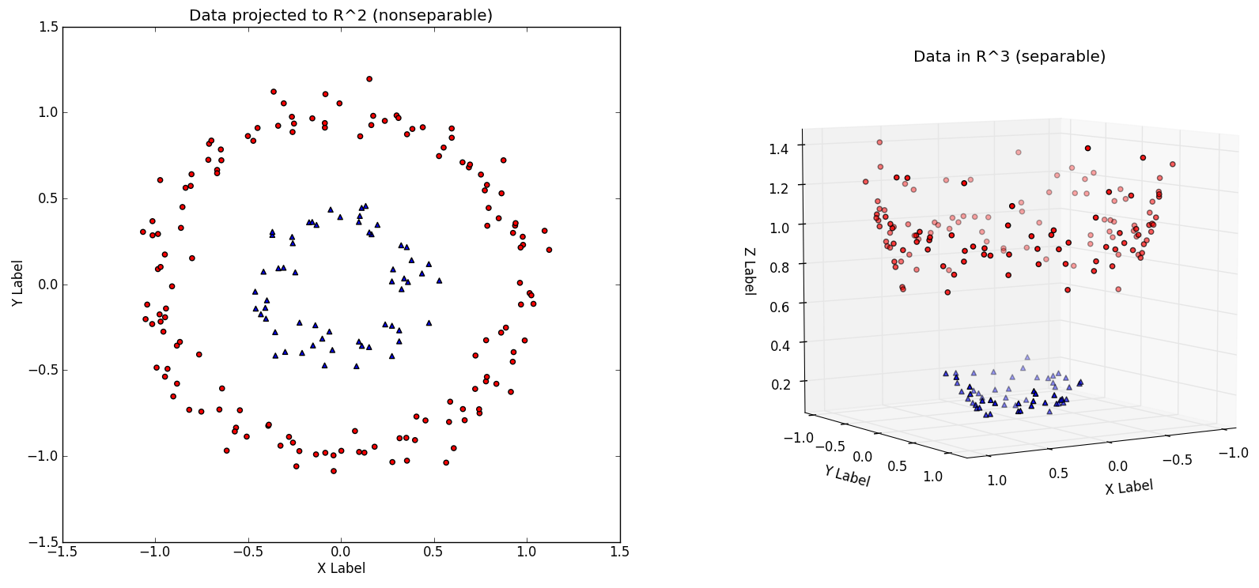
1) Complex Data - Solution
Why?

Slide 9
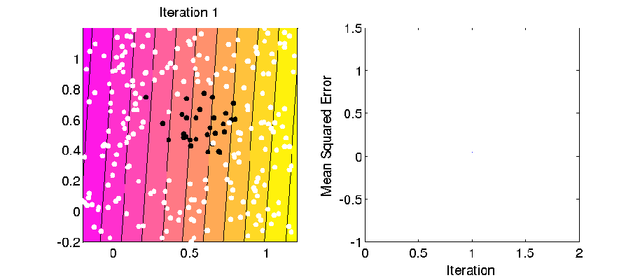
1) Complex Data - Solution
Why?

Slide 10
1) Complex Data - Solution
Why?

Slide 11

2) Parallel Calculations
Why?

Slide 12
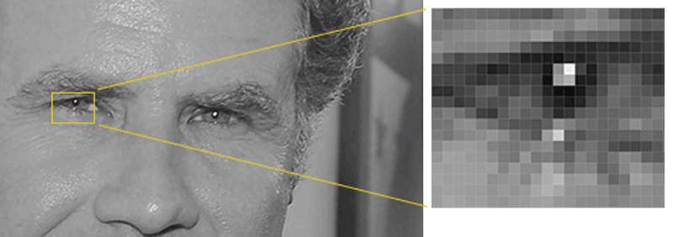
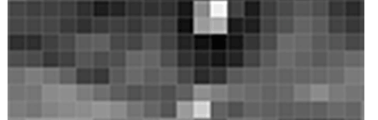
2) Image Recog - Pixel Vectors
Why?

Slide 13

2) Image Recog - Gradient Vectors
Why?

Slide 14
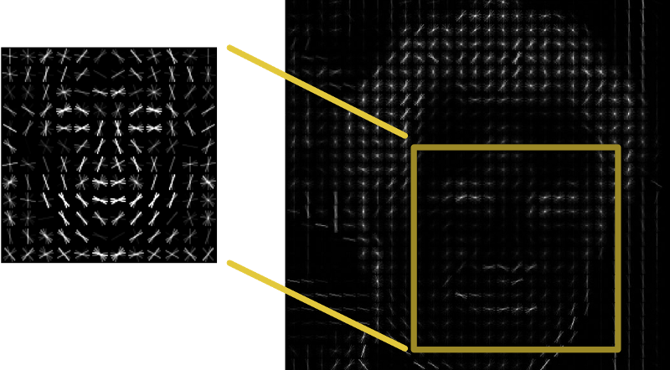
2) Image Recog - Gradient Vectors
Why?

Slide 15
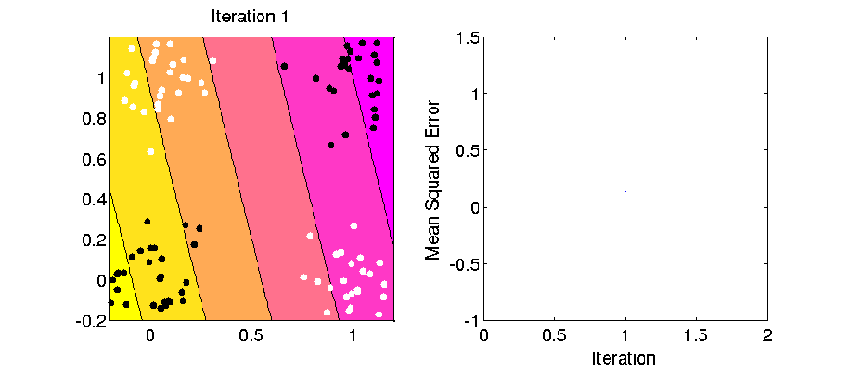
3) Self Teaching
Why?

Slide 16

3) Self Teaching
Why?

Slide 17
Summary: Why?
Why?
Benefits
Allow for extremely complex cases
More ‘practical’ than elegant mathematical solutions
Less intensive development time up front
Flexibility
Weaknesses
Relatively computationally expensive vs standard methods (regression)
More ‘black box’, intermediate results can not necessarily be interpreted by humans
Skynet? - harder to ‘control’ and less intuitive heuristics than other methods
Questions at this point?

Slide 18
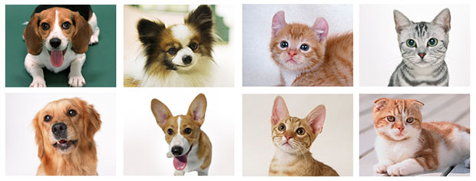
So What Are Neural Networks?
What?

Slide 19
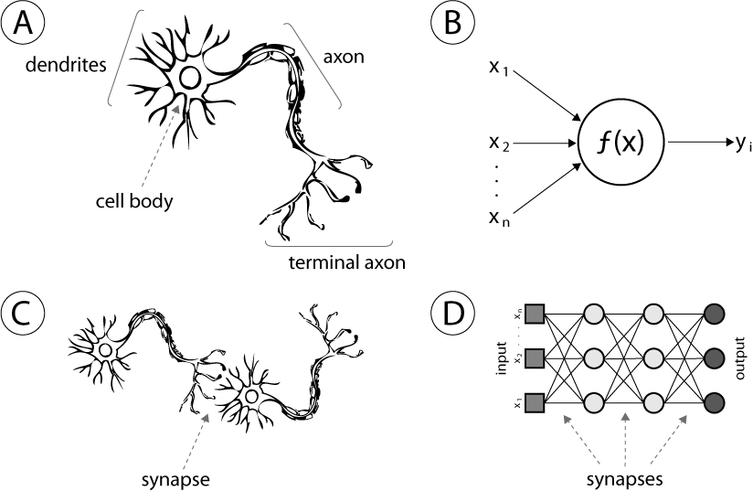
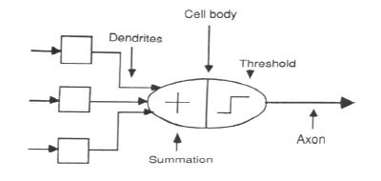
More Human Than Human
What?
Error minimizing functions- prediction, classification, generation
General framework- regression, etc. can be expressed as a neural network
Biological emulation, not mathematical formula/model
Neurons
Layers

Slide 20
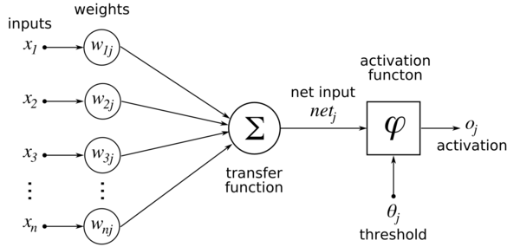
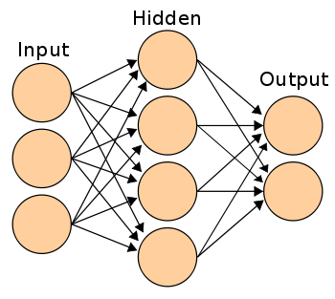
Hidden Layers & ‘Deep’ Learning
What?

Slide 21
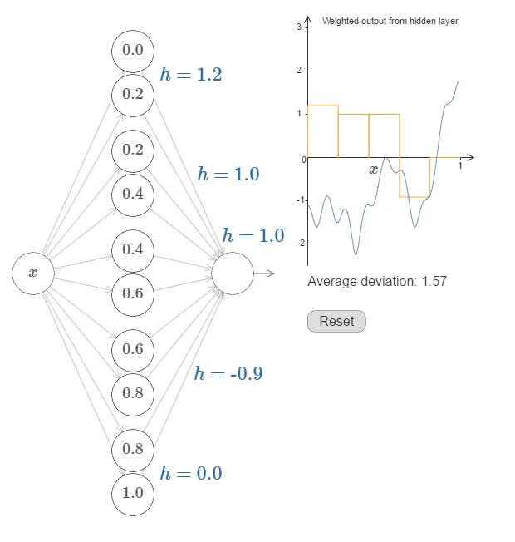
The Whole > Sum of Parts
What?

Slide 22
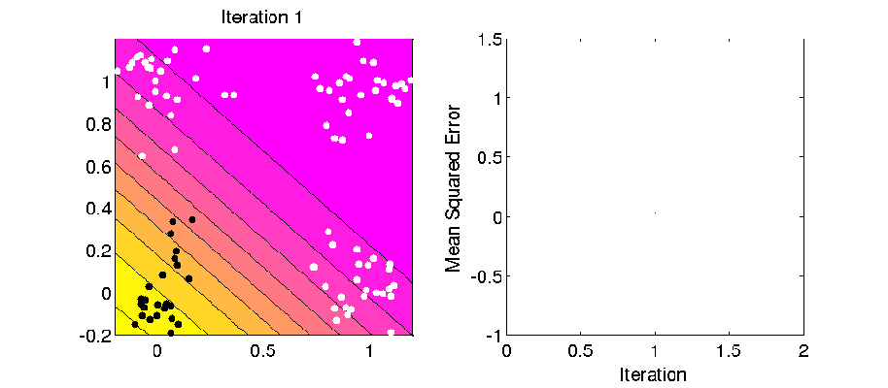
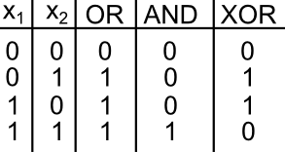
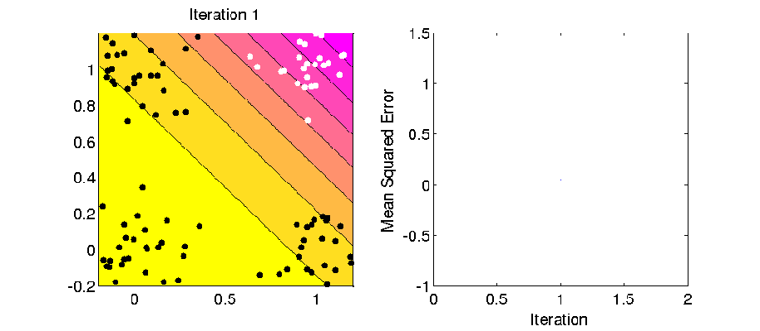
Deeper Dive – Perceptrons
What?

Slide 23
Special Cases - Neural Networks?
What?
Convolutional
Recurrent
Used for image recognition
Uses overlapping data to find abstracted ‘features’ ie… a nose, a stop sign, a dog, etc.
Helps cut down on massive amount of size images contain
Pattern recognition
Used for time series and heavily in Natural Language Processing (NLP)
Same layer nodes interconnected as they are contextually dependent

Slide 24
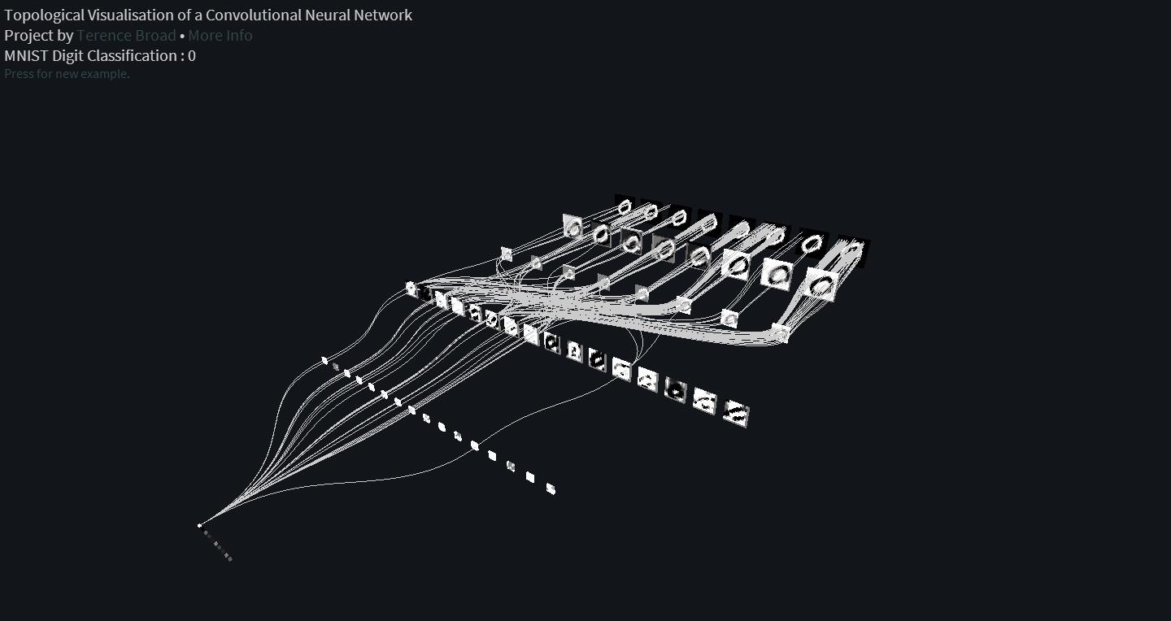
Special Case - Convolutional
What?

Slide 25
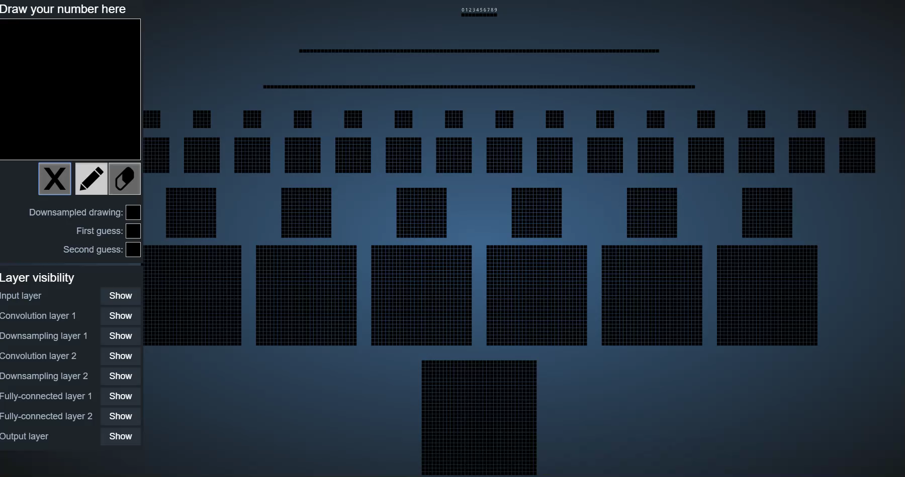
Special Case - Convolutional
What?

Slide 26
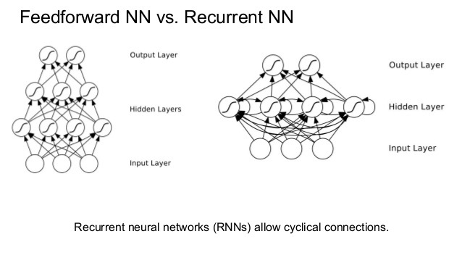
Special Case - Recurrent
What?

Slide 27
Summary: What?
What?
High Level
‘Ground up’ emulation of the human brain
Can be used predict, categorize, or generate
If it can be quantified, a neural net can be used – but not always best choice
Deeper Dive
Each ‘neuron’ can thought of as a voter whose weighted votes generate an output
Convolutional NN are used for image recognition
Recurrent NN are used in NLP and time series prediction
Many other special sub-cases exist (or are being developed)
Questions at this point?

Slide 28
How Do NNs Work?
How?
Components
Input layer
Weights from input layer to hidden layer (if any)
Weights from hidden layer (if any) to output layer
Activation Function
Output layer
Process
Feed data forward
Measure error
Feed data backward (learning)

Slide 29
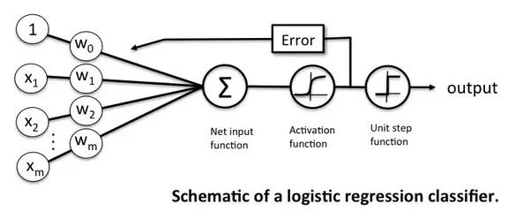
High Level - Components
How?
Input layer (given)
Weights to hidden (initialized)
Activation function (hyperparameter)
Weights to output (initialized)
(Final) Activation function (hyperparameter)
Output layer

Slide 30
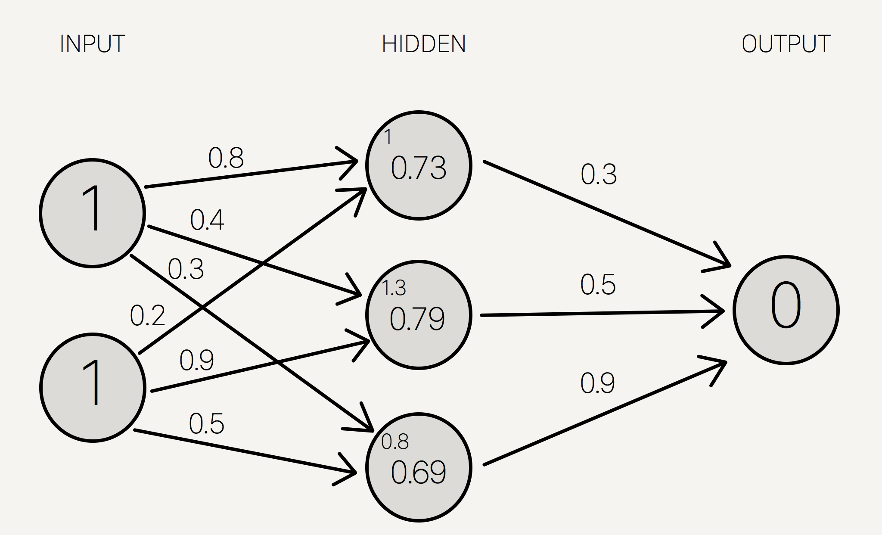
High Level - Process
How?
Feed data forward
Multiply inputs by weights
Sum at each hidden node
Run sum through activation function
Take output and multiply by weights…
Measure error
Measure output vs expected (given)
Calc direction and magnitude
Update weights
Propagate error back through proportionally
Change weights and repeat

Slide 31
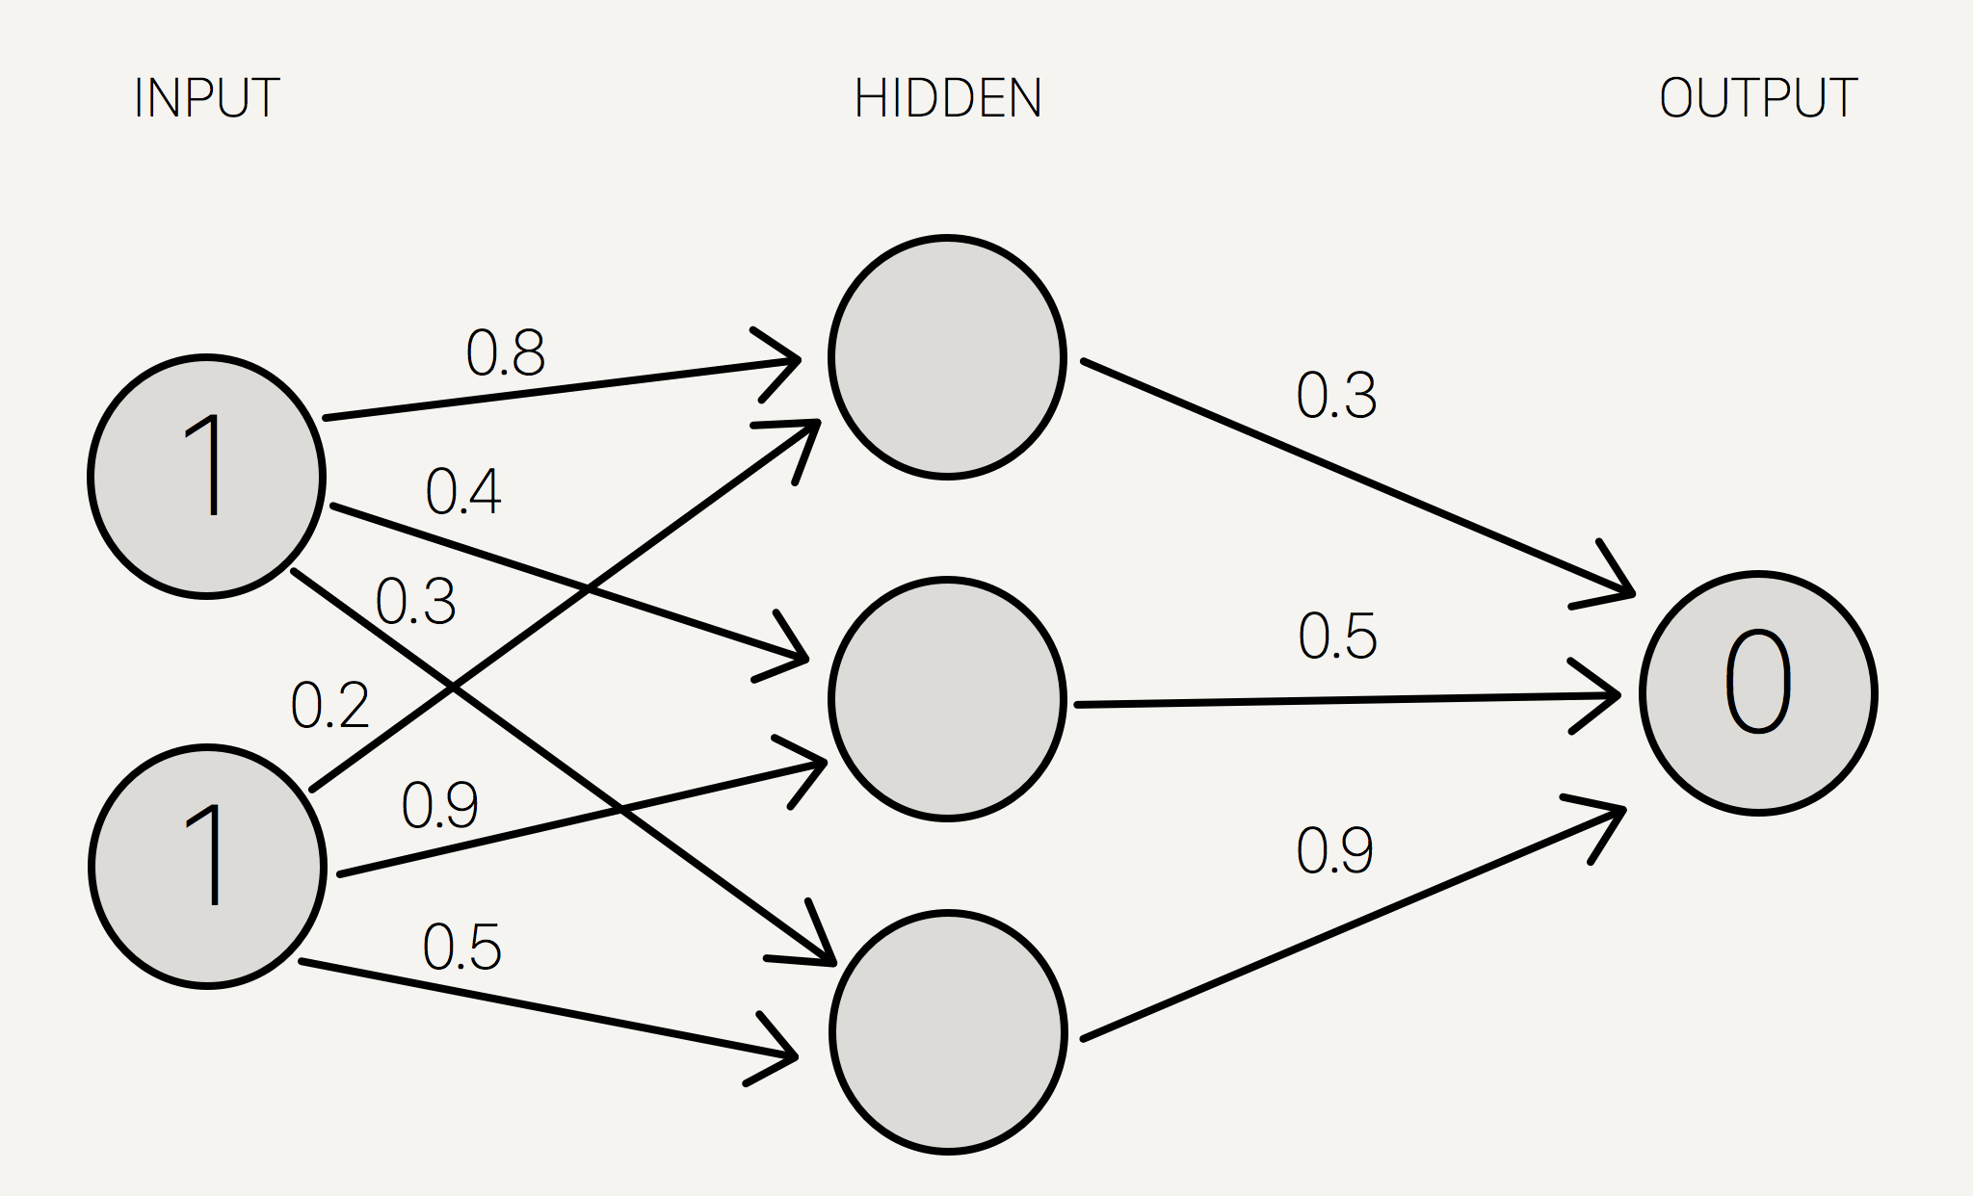
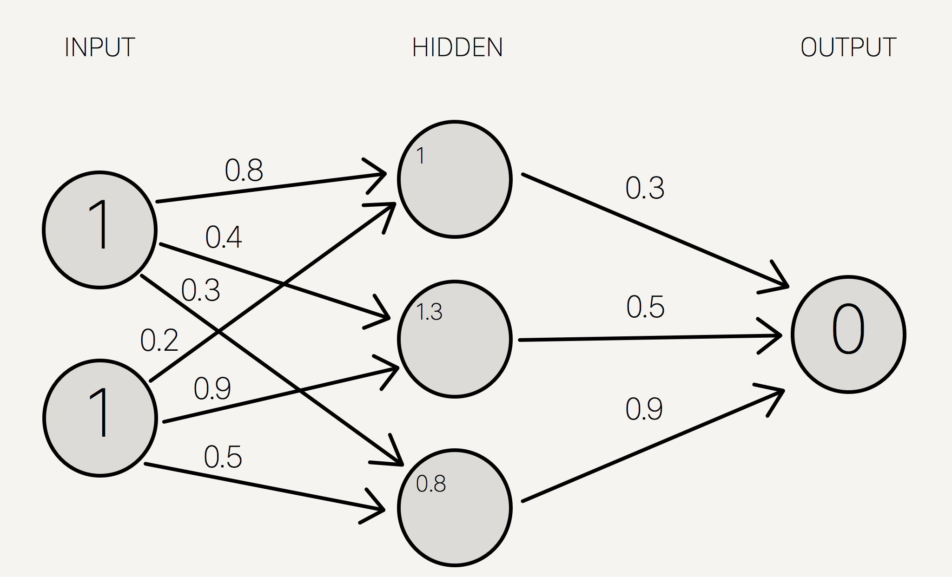
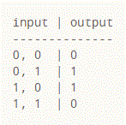
Deeper Dive – First Layer
How?

Slide 32
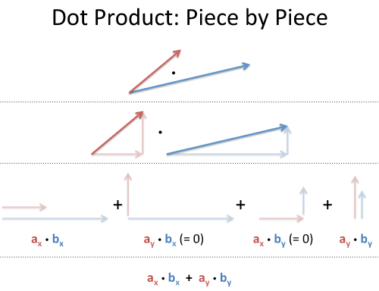
Deeper Dive – Forward Propogation
How?

Slide 33
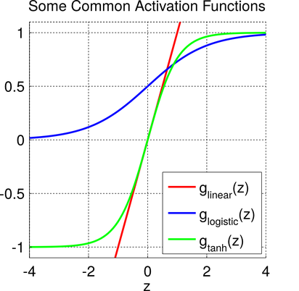
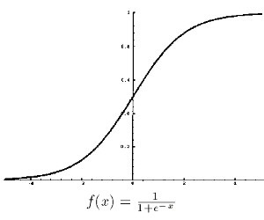
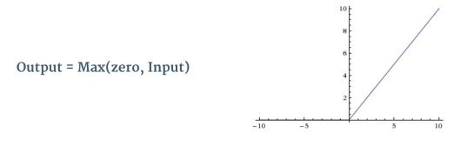
Deeper Dive - Activation
How?

Slide 34
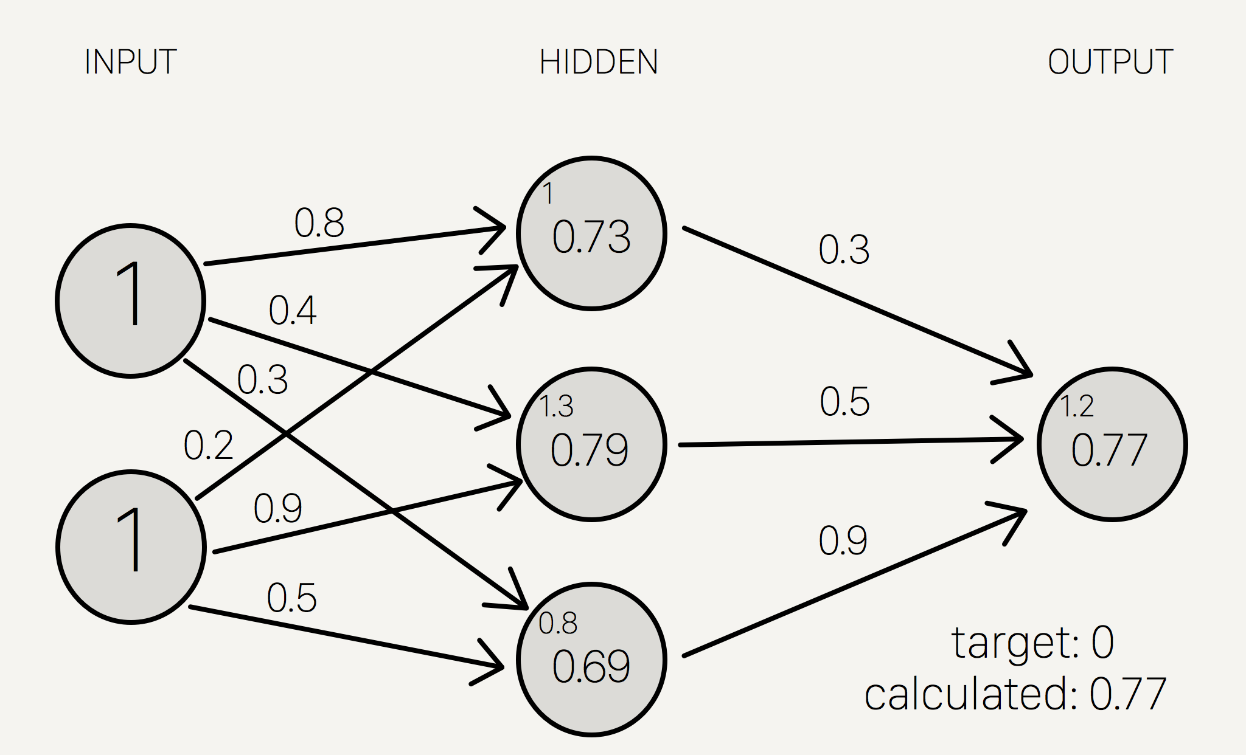
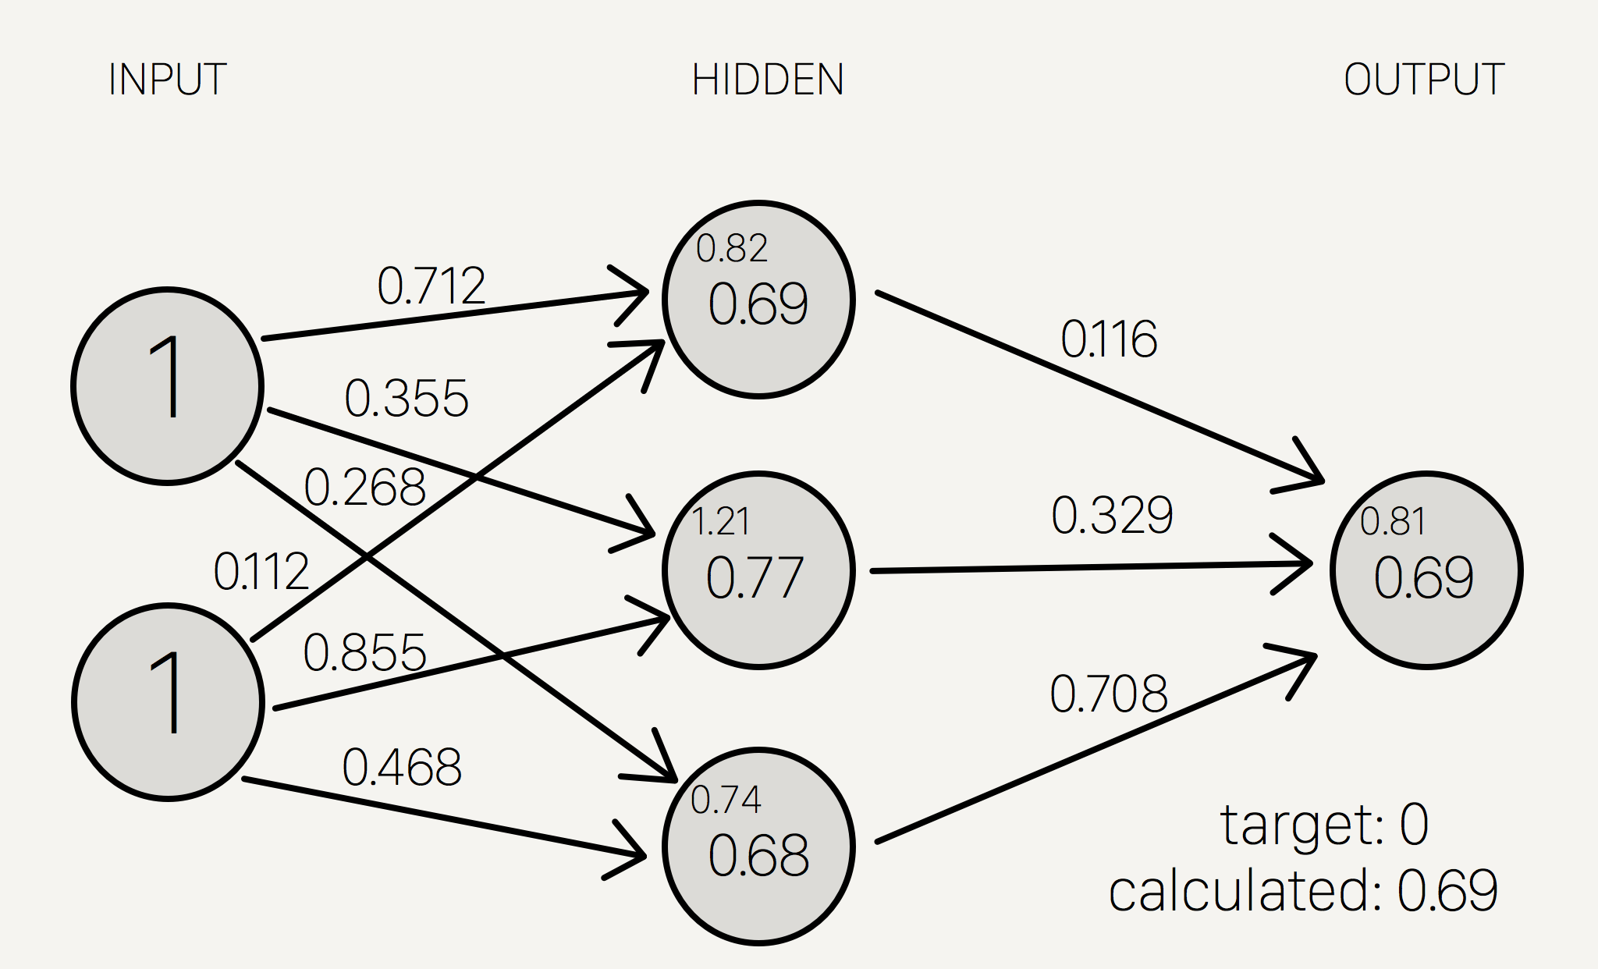
Deeper Dive – Error
How?

Slide 35
Deeper Dive – Backward Propogation
How?
Backward Propogation
Have direction of error (+/-)
Have slope (gradient) from point of activation and tangent line
From these two, we can calculate an ‘error term’ that indicates both what direction to update weights and by how much
Implement algorithm like Gradient Descent or Stochastic Gradient Descent to minimize error

Slide 36
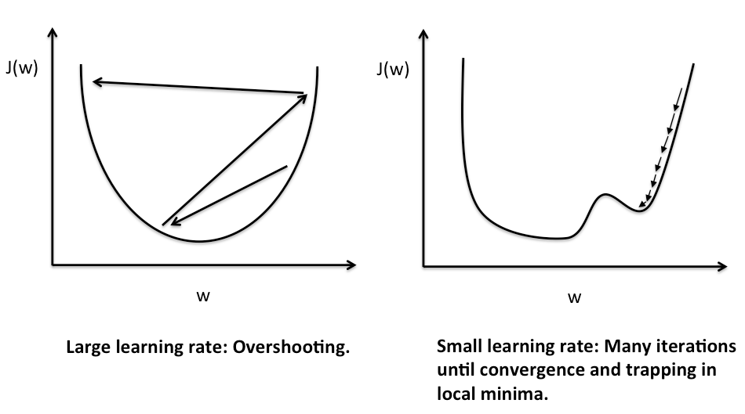
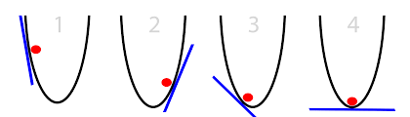
Deeper Dive – Gradient Descent
How?

Slide 37
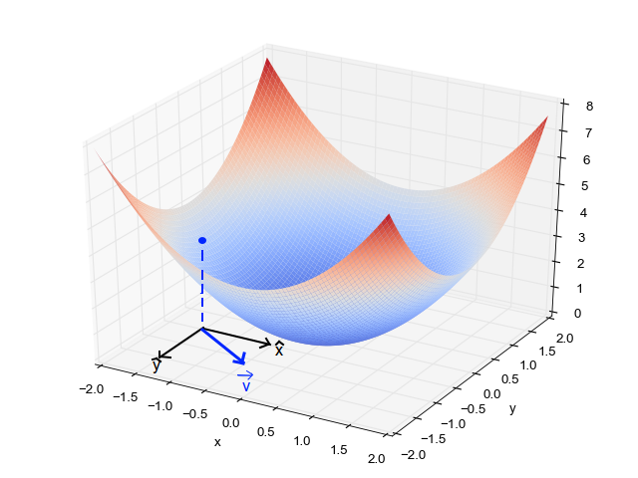
Deeper Dive – Gradient Descent
How?

Slide 38


Special Cases - Convolutional
How?

Slide 39
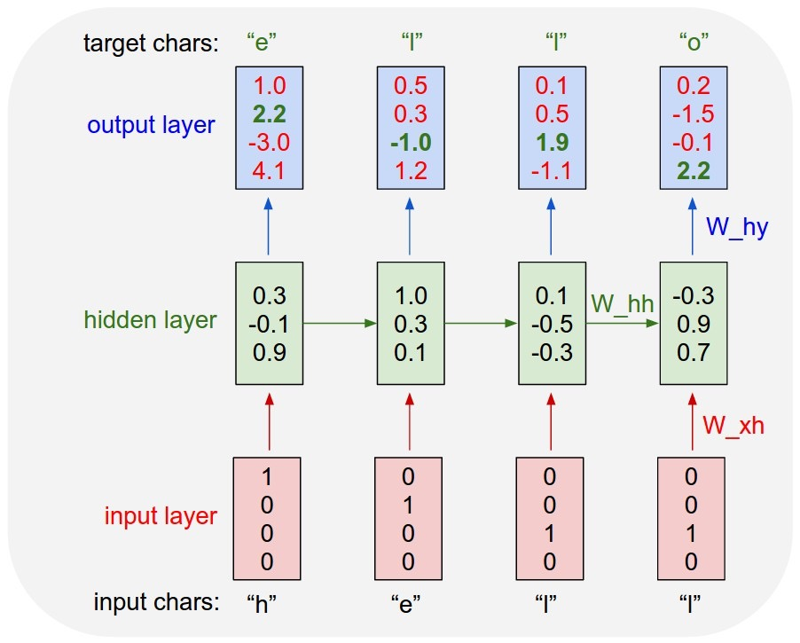
Special Case - Recurrent
How?

Slide 40
How Do They Work? – Code
How?
Manually implemented example in Python
Will distribute file so no need to code along
Questions so far?

Slide 41
Matt R O’Connor http://Reboot.ai 6289.9447 matt.oconnor217@gmail.com linkedin.com/in/mattroconnor/

Slide 42
Resources
http://mccormickml.com/2014/03/04/gradient-descent-derivation/
http://eli.thegreenplace.net/2016/understanding-gradient-descent/
https://theclevermachine.wordpress.com/2014/09/06/derivation-error-backpropagation-gradient-descent-for-neural-networks/
https://arxiv.org/pdf/1701.01887.pdf
https://ujjwalkarn.me/2016/08/11/intuitive-explanation-convnets/
http://karpathy.github.io/2015/05/21/rnn-effectiveness/
https://stevenmiller888.github.io/mind-how-to-build-a-neural-network/
https://theclevermachine.wordpress.com/2014/09/11/a-gentle-introduction-to-artificial-neural-networks/
https://www.quora.com/What-is-the-role-of-the-activation-function-in-a-neural-network
https://theclevermachine.wordpress.com/2014/09/11/a-gentle-introduction-to-artificial-neural-networks/
https://www.quora.com/Why-do-neural-networks-with-more-layers-perform-better-than-a-single-layer-MLP-with-a-number-of-neurons-that-leads-to-the-same-number-of-parameters
http://neuralnetworksanddeeplearning.com/chap4.html
https://ujjwalkarn.me/2016/08/11/intuitive-explanation-convnets/
http://scs.ryerson.ca/~aharley/vis/conv/flat.html

